Slide 1
Pioneers Real Estate
Pioneers
Aman Singh
Manreet Lotay
Mohamed Bedair
Naika Jean-Baptiste
Seif Bedair

Slide 2
Project Purpose
Creating a one-stop shop for homebuyers, renters, and brokers
Homebuyers need a fast way to find trusted brokers and view properties.
Brokers pay a monthly subscription, as well as a 0.5% commission fee on completed sales.
Secure Login System implemented using JWT tokens for customized user views

Slide 3
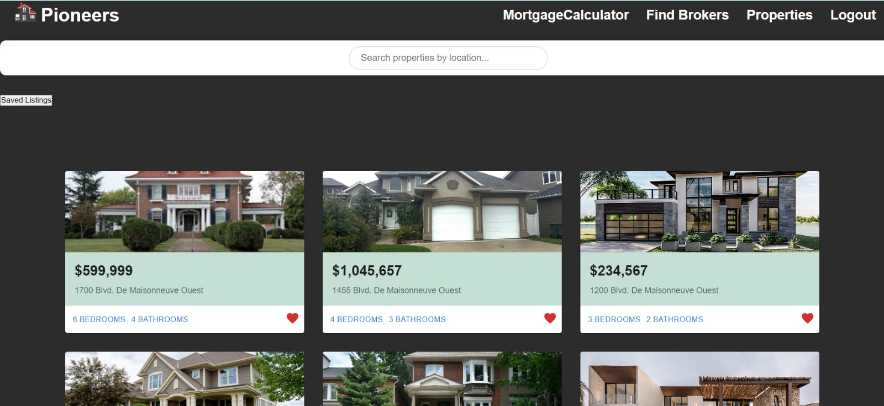
Viewing Properties

Slide 4
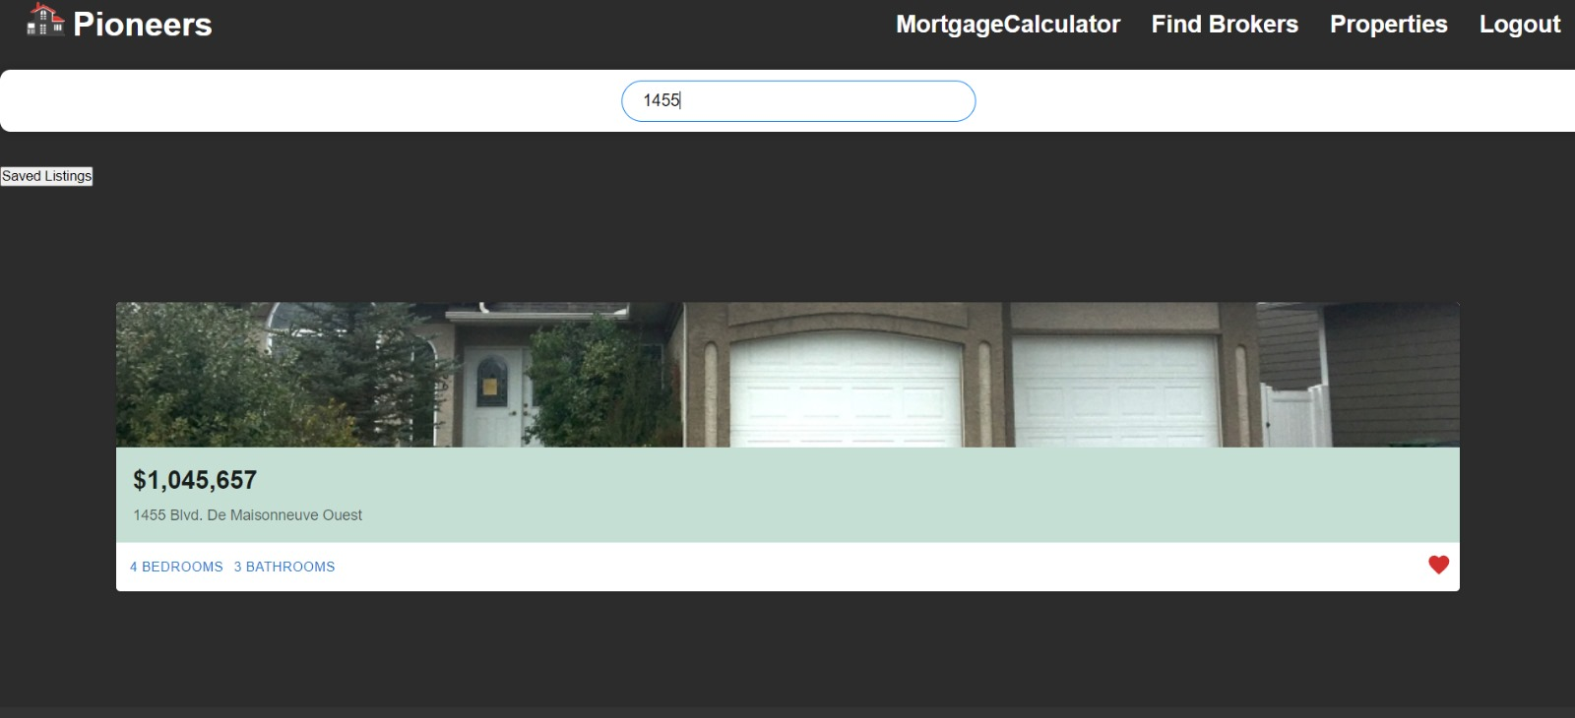
Searching

Slide 5
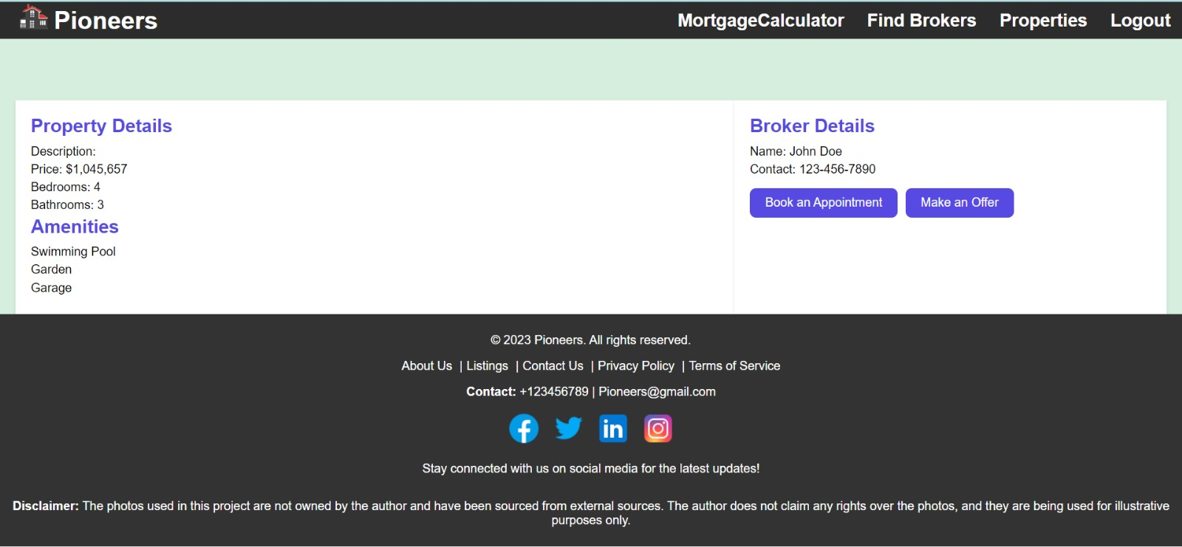
Listing Details

Slide 6
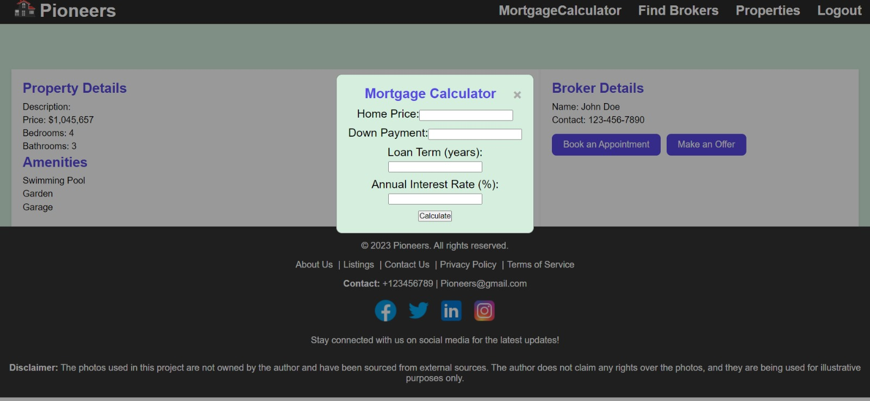
Mortgage Calculator

Slide 7
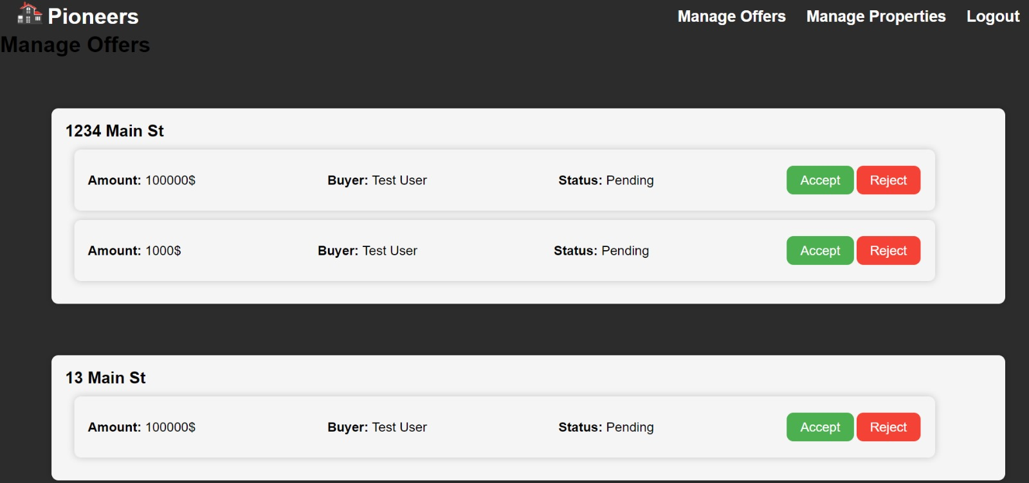
Managing Offers

Slide 8
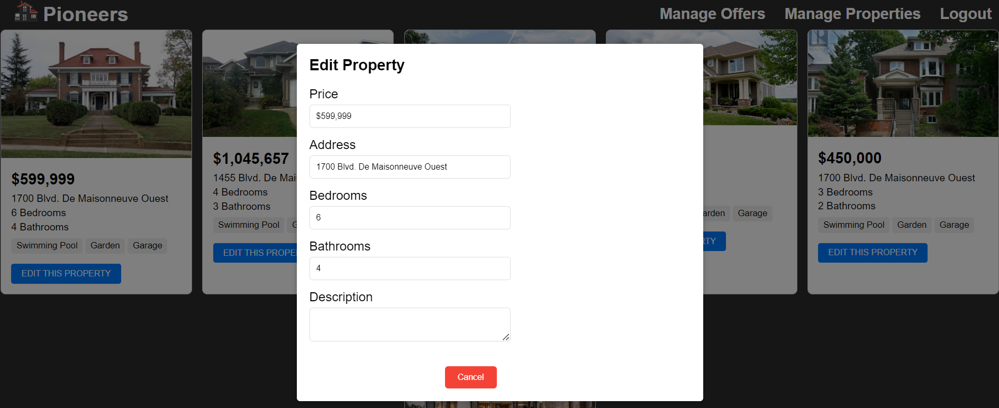
Editing Properties

Slide 9
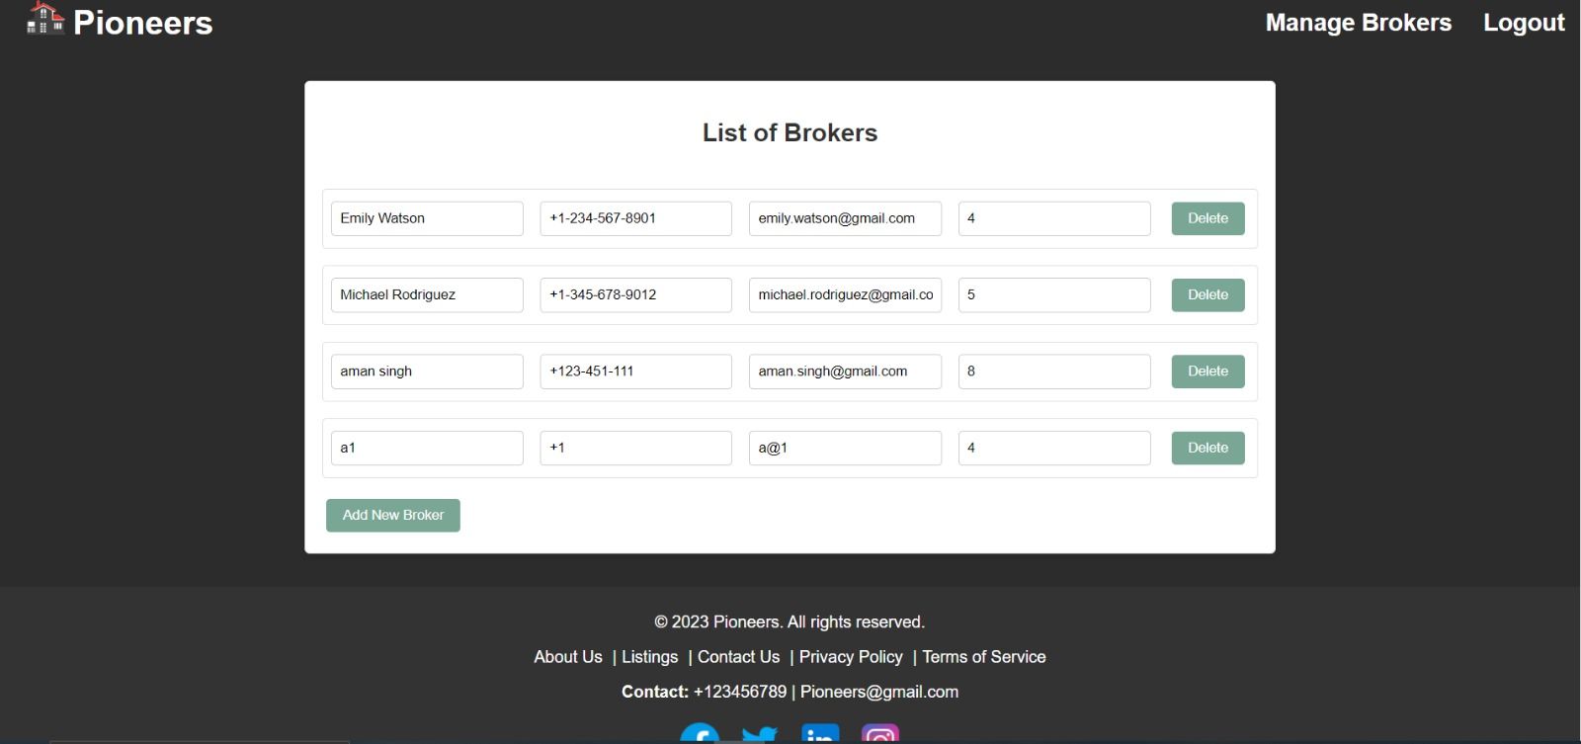
Managing Brokers

Slide 10
User Benefits
You can access all postings from different brokers all in one place
You can book appointments online without having to contact the broker
Brokers can manage all offers in one place
No limits on broker homes
Free to use for homebuyers and renters!

Slide 11
Competitive edge
We offer a safe and reliable service that is free of charge
Wide selection of brokers and listings
Map view for listings
Secure login system

Slide 12
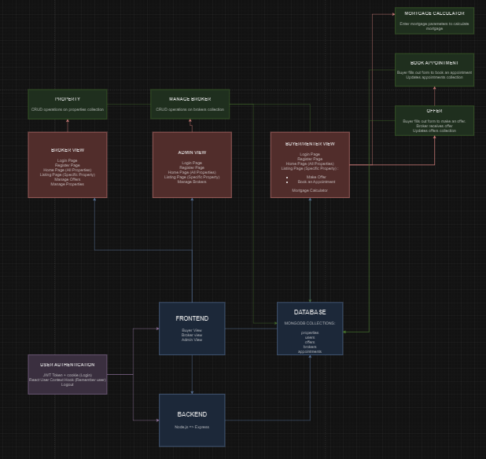
Overall Architecture

Slide 13
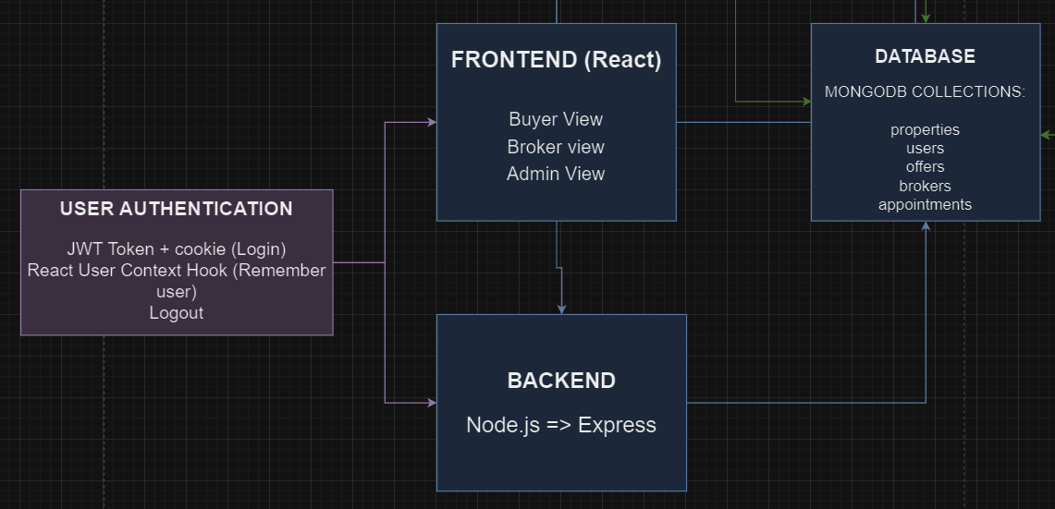
Overall Architecture

Slide 14
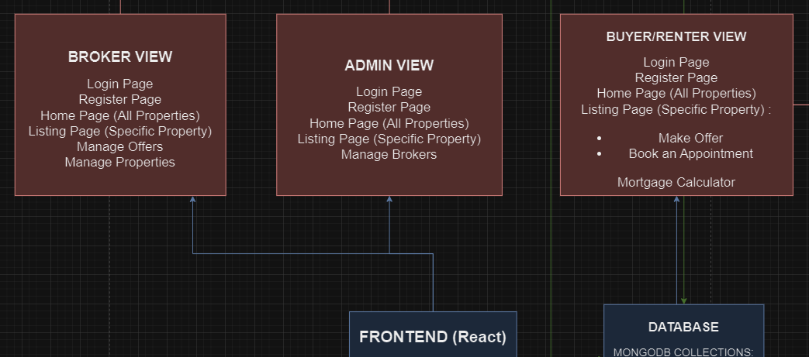
Overall Architecture

Slide 15
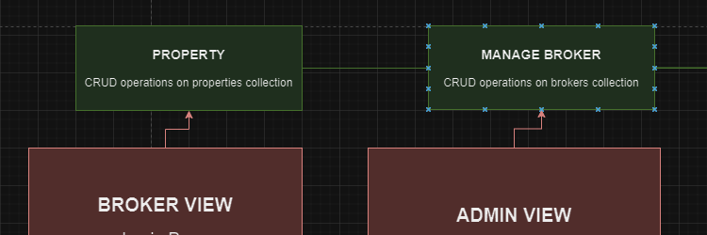
Overall Architecture

Slide 16
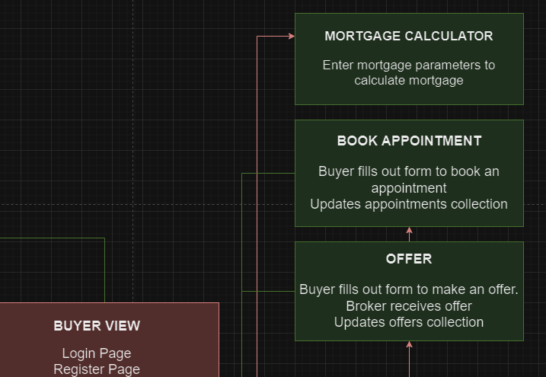
Overall Architecture

Slide 17
Project overview
Java Script, HTML, CSS
13 User Stories
154 Commits

Slide 18
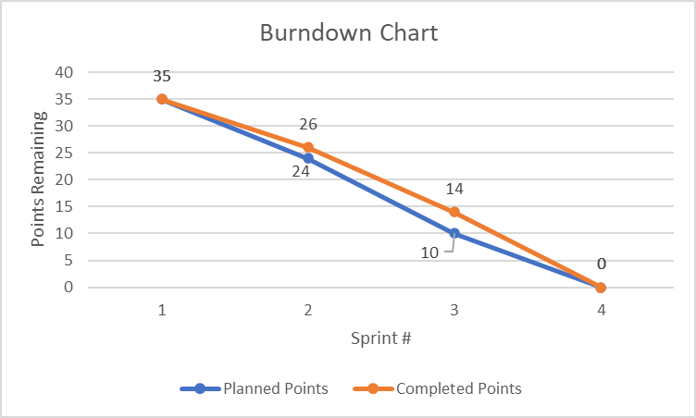
Burndown Chart

Slide 19
Frameworks Employed: React
useState, useEffect, and useContext hooks for user persistence
React-Router-Dom to set up routes in the website.
Material UI library to use components such as Card, Grid

Slide 20
Frameworks Employed: Express
Mongoose library to create models and manipulate collections in MongoDB.
Cors middleware to connect front and back-end ports.
Cookies and JWT tokens to handle user authentication
Defined endpoints to perform CRUD operations on various collections

Slide 21
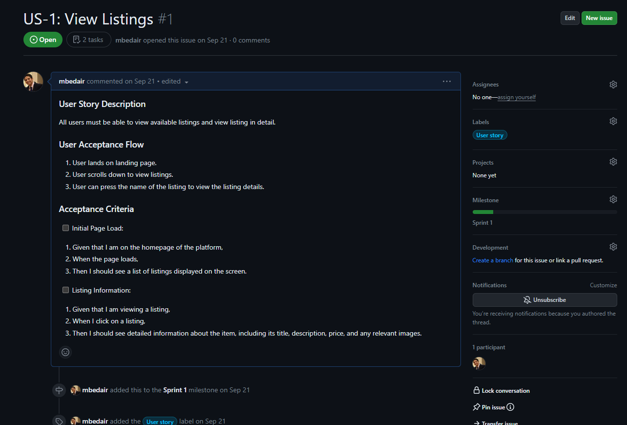
User Story 1

Slide 22
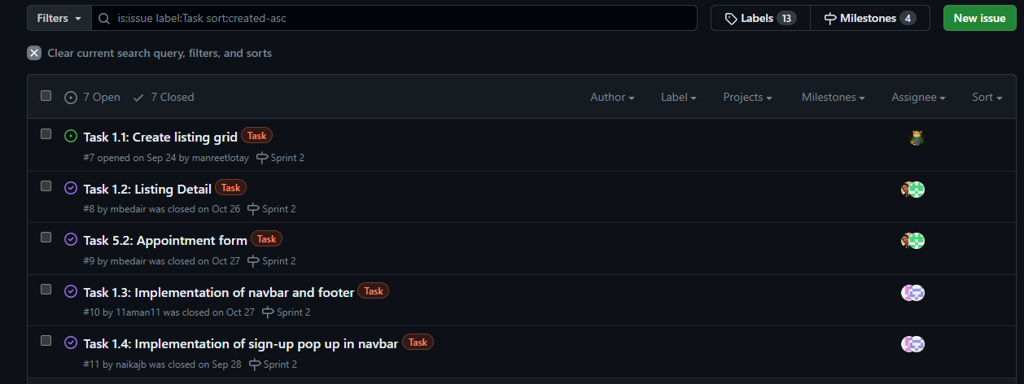
User Story 1

Slide 23
Lesson Learned
Uniform code structure was extremely important
Rollback on github is an essential feature
Never commit to main always use pull requests and branches
Front end using react is convenient and easy to manage routes

